Slide 1
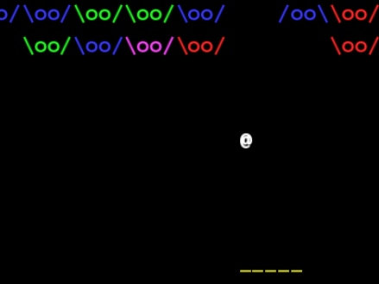
Squill Squisher
A Team 203 Production
By Paul Orvis and TJ Meehan

Slide 2
Concept:
Players bounce a single “bullet” around an arena
Goal is to squish your adversaries
Aliens known as the “Squill”
Players have access to powerups by squishing enemies
Clearing the arena advances you to the next level
Levels increase in difficulty as time goes on
It’s basically “Breakout” to be honest!
But with a cool narrative?

Slide 3
Game Features:
Bullet “bounces” off objects and walls realistically
Custom functions use trig to calculate new direction
Important to maintain constant overall speed
Able to detect orientation of surface (enemy, wall, paddle)
Bullet moves faster and Squill HP increases as game progresses.
Unlock 3 power-ups to help you:
Power-up that doubles the bullet’s power.
Power-up that increases the size of the paddle.
A bomb which destroys a massive amount of Squills.
Game is over when player loses all their lives.
Currently 3 levels with increasing difficulty to play.

Slide 4
Sound Design
Very sound heavy game
Prepared music for main menu plus 9 level tracks
Only ended up using 3 levels in current release
Different sound effects for game events
Hitting an enemy, wall, paddle…
Killing an enemy, getting a powerup
Clearing a level, beating the game, losing the game

Slide 5
Let’s watch a trailer!
https://youtu.be/u8FevSQuN9U

Slide 6
Live demo?

